Slide 1
FINANCIAL SENTIMENT ANALYSIS
PROJECT TITLE
P-202

Slide 2
PROJECT DETAILS
NAME OF TEAM - P202/TEAM_2
MENTOR - NEHA GUPTA / HAREESH
TEAM MEMBERS - 1) Mr. ANUJ KUMAR
2) Mr. DATTATRAY BODAKE
3) Mr. IRFAN SHAIK
3) Mr. AKSHAY
5) Mr. RAHUL GANDHASIRI
6) Mr. RAM GOUD
7) Ms. SUPRIYA DUSTHAKAR

Slide 3
PROJECT FLOW
Business Objective
Data Set Details
Exploratory Data Analysis
Model Building
Model Evaluation
Deployment

Slide 4
BUSINESS OBJECTIVES
Need to get sentiment analysis of financial statements and gauge its impact i.e. positive, negative or neutral on the business and government.

Slide 5
WHAT IS SENTIMENT ANALYSIS ?
sentiment analysis is the process of using natural language processing (NLP) and machine learning techniques to analyze the sentiment (positive, negative, or neutral) of a piece of text, such as social media posts, customer reviews, or news articles.
The purpose of sentiment analysis is to understand and extract insights from the opinions, attitudes, and emotions expressed in the text data.
Sentiment analysis is a valuable tool for businesses and organizations to understand customer feedback and sentiment towards their products, services, and brand. It can help them identify areas for improvement, track customer satisfaction over time, and respond to negative feedback in a timely manner.
Additionally, sentiment analysis can be used in political analysis, financial forecasting, and other applications where understanding public opinion is important.
Regardless of the method used, sentiment analysis typically involves data collection and preprocessing, feature extraction, and machine learning model training and evaluation.

Slide 6
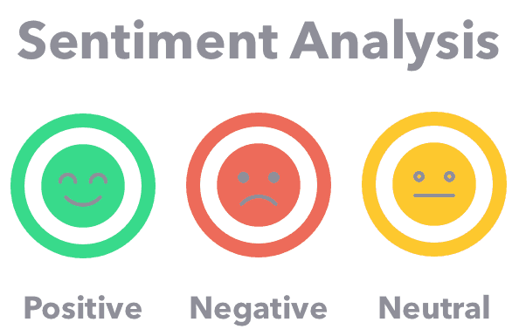
Overall, sentiment analysis is a powerful technique that allows businesses and organizations to gain insights into customer sentiment and opinion, and make data-driven decisions to improve their products and services.

Slide 7
Process of sentiment analysis:
Data Collection: Sentiment analysis begins with collecting relevant data from various sources, such as social media, customer reviews, or news articles.
Text Preprocessing: The collected data is then preprocessed to remove any irrelevant or duplicate information, and to standardize the data format. This step typically involves tasks such as tokenization, stop word removal, and stemming or lemmatization.
Feature Extraction: The next step is to extract relevant features from the text, such as keywords or phrases, that can help identify the sentiment of the text. There are several techniques for feature extraction, including bag-of-words, n-grams, and word embeddings.
Sentiment Classification: Once the features are extracted, sentiment classification algorithms are used to determine the sentiment of the text. Machine learning-based methods. Machine learning-based methods, such as Naive Bayes, Support Vector Machines (SVM), or Recurrent Neural Networks (RNN), are commonly used for sentiment classification.
Model Training and Evaluation: To build a high-quality sentiment analysis model, the algorithms used for sentiment classification are trained on a labeled dataset of text data. The model is then evaluated to determine its accuracy and effectiveness in classifying sentiment. This step involves measuring the model's performance on a test dataset using metrics such as accuracy, precision, recall, and F1-score.
Sentiment Visualization: Finally, the sentiment analysis results are visualized using charts, graphs, or other visual aids to help communicate the insights gained from the data analysis.

Slide 8
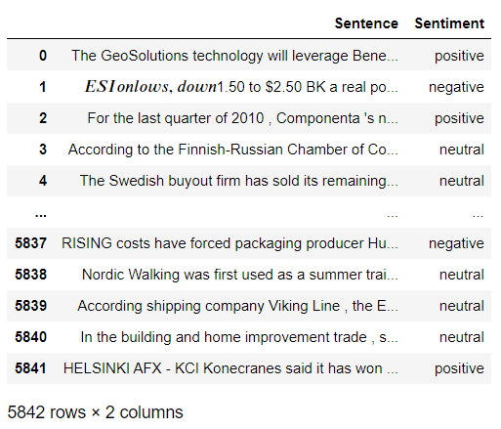
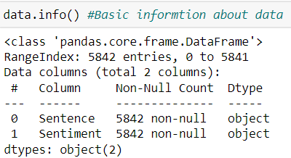
DATASET DETAILS
The Data contains 5842 rows and 2 columns.
By directly looking to the dataset we find that sentiments really make sense.
Data is Unstructured.
By looking at the data, we find that our data contains various punctuations, special symbols, links etc.
So we need to clean our data as well.
Because these punctuations, symbols doesn't give any sentiment.

Slide 9
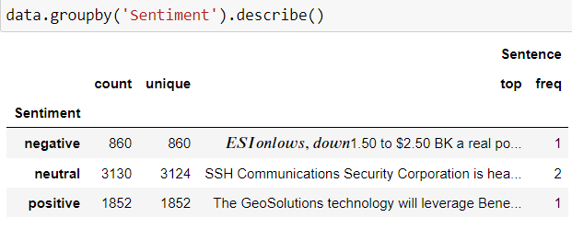
EXPLORATORY DATA ANALYSIS
Conclusion:
i) Imbalanced data
ii) No. Positive sentence - 1852
iii) No. Negative sentence - 860
iv) No. Neutral sentence - 3130
Positive Sentences are more than Negative Sentences.

Slide 10
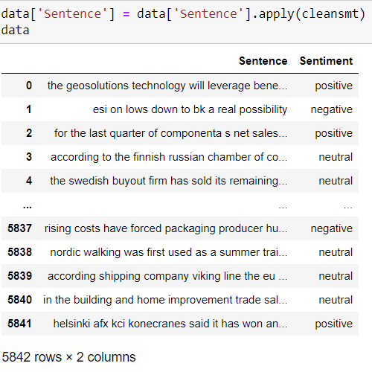
Text Preprocessing:
Remove 'RT' from sentence
Remove the '#' from the sentence
Remove the '\n' character
Remove the hyperlinks
Remove @mentions
Remove leading and trailing whitespaces
Remove emojis
Converting to lower
Data after Text Preprocessing

Slide 11
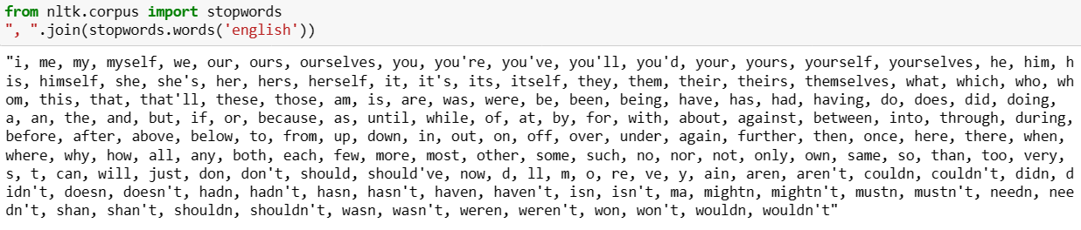
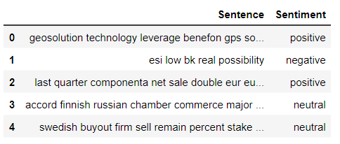
Removing Stop Words:
Removing stop words means excluding common words from a text that are considered to have little or no value in conveying meaning and are often ignored by search engines when indexing content.
Data After Removing StopWords

Slide 12
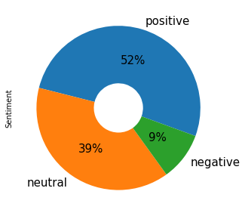
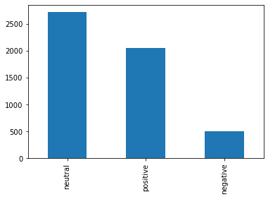
Visualization:-
Barplot
Pie Chart

Slide 13
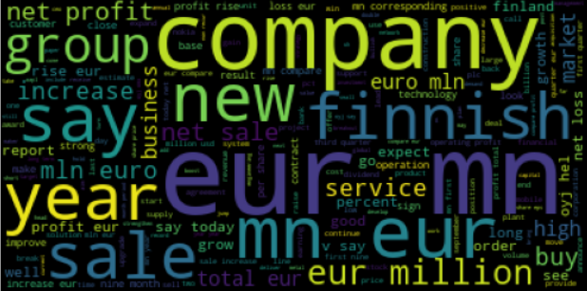
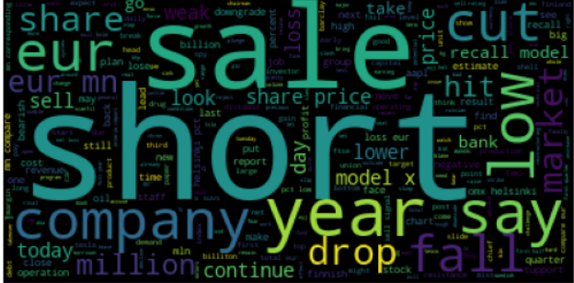
WORD CLOUD:
Word Cloud For Positive Words
Word Cloud For Negative Words

Slide 14
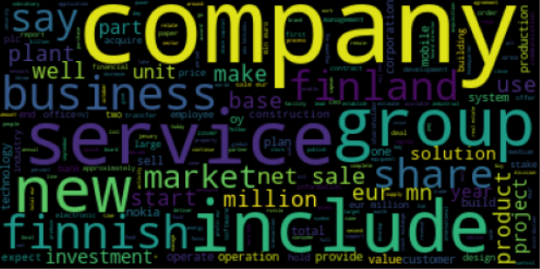
Word Cloud For Neutral Words

Slide 15
FEATURE EXTRACTION:
Feature extraction is the process of transforming raw data or information into a set of features or numerical representations that can be used to represent the data in a way that is easier to analyze, understand, and process.
It involves selecting relevant features from the input data, and transforming or encoding them in a way that captures their essential characteristics.
In machine learning and data mining, feature extraction is an important step in preparing the data for analysis and modeling.
It helps to reduce the dimensionality of the input data, which can be important for computational efficiency, and to identify the most important and informative features for the task at hand.
Feature extraction is widely used in a variety of applications such as image processing, natural language processing, speech recognition, and many others.

Slide 16
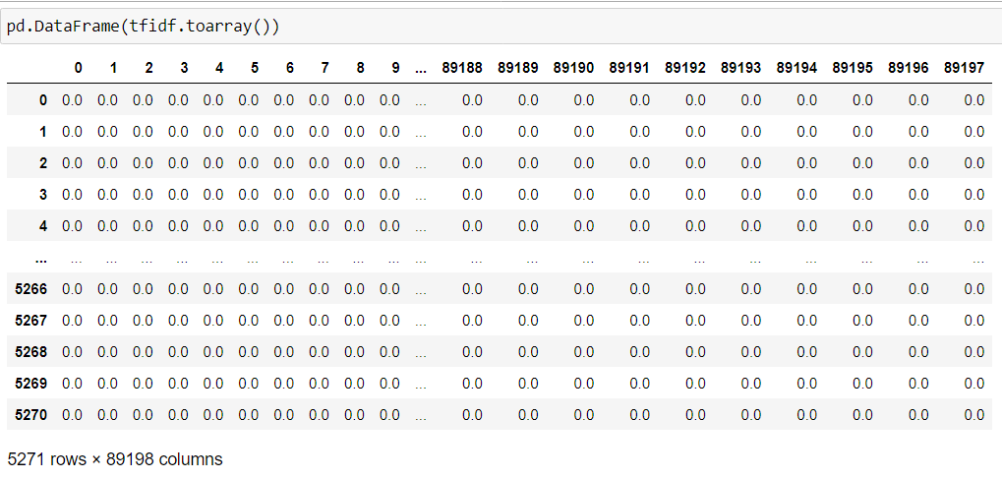
TF-IDF (Term Frequency-Inverse Document Frequency):
TF-IDF (Term Frequency-Inverse Document Frequency) is a numerical statistic that reflects the importance of a term or word in a document or corpus of documents. It is a popular weighting scheme used in information retrieval and text mining to evaluate the relevance of a document to a particular search query or topic.
The term frequency (TF) measures the frequency of a term in a document, i.e., the number of times a term appears in a document.
The inverse document frequency (IDF) measures the rarity of a term across the corpus of documents, i.e., the less frequent a term is in the corpus.
The formula to calculate the TF-IDF value of a term is:
TF-IDF = TF * log(N/DF)
where
TF = term frequency of the term in the document
DF = number of documents containing the term
N = total number of documents in the corpus
TFIDF using (Unigram + Trigram

Slide 17
MODEL BUILDING:
Model building is the process of creating a mathematical or statistical model that represents a real-world system, process, or phenomenon. In the context of sentiment analysis, model building involves creating a machine learning model that can accurately predict the sentiment of a piece of text based on its features.
Here we have applied the following Models:
Gaussian Naïve Bayes
Support Vector Machine
Light GBM Classifier
Random Forest Classifier

Slide 18
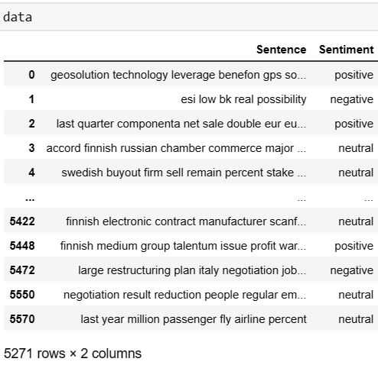
Here is the clean data for Model Building after Text Pre-processing, Cleaning, removing duplicates sentences
For Machine Learning model Building we have used 5271 sentences.
We have used TF-IDF (Unigram + Trigram) for Final Model Deployment

Slide 19
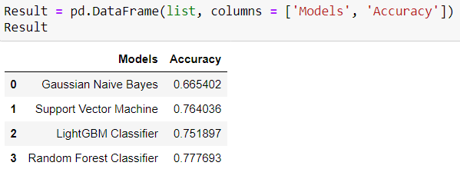
MODEL EVALUATION:
Best Accuracy for Random Forest Classifier i.e 77.7693

Slide 20
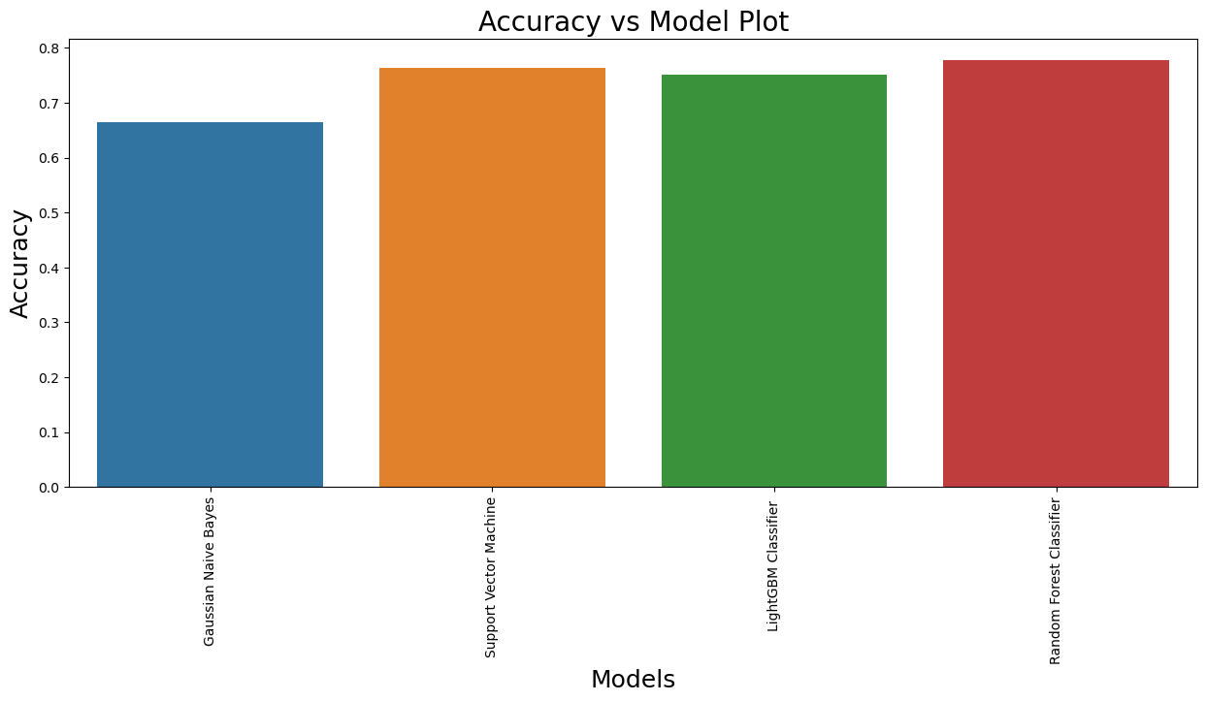
COMPARISON OF MODELS:

Slide 21
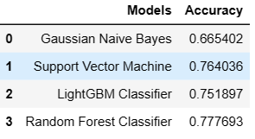
SELECTING THE BEST MODEL:- (Random Forest Classifier )
In this classification model we have created different models using ML Algorithms to measure the performance of the model that gives us best accuracy rate to predict the data.
As we have the performance results with us for the models, we will select the best one out of them which suits for our business models and predicts correctly.
Random Forest Classifier suits best for our model and gives the perfect prediction.

Slide 22
MODEL DEPLOYMENT Locally: Part 1
Model deployment using Random forest classifier
Before we deploy our model, we need to load our model in our pickle format from where streamlit will run our main python file.
We use the below code to prepare the .pkl file and save it in our path.
Preparing the python file with our parameters(with all our prediction variables)
Saving the .py and .pkl file in our path so that we can run them locally.
We can deploy the model using anaconda prompt > create a virtual environment > create a folder to store our data files> run that folder using streamlit command.

Slide 23
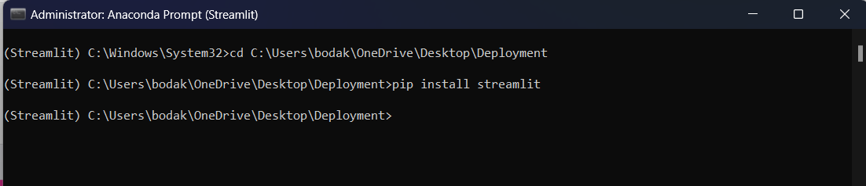
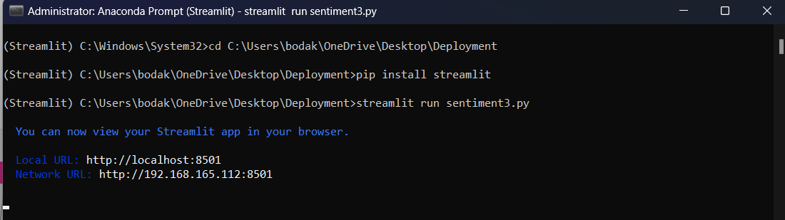
MODEL DEPLOYMENT Locally: Part 2
Create a virtual environment and data folder in your local disk.
Run the model using streamlit (i.e. streamlit run sentiment3.py). Which will create a local page (http://localhost:8501/)

Slide 24
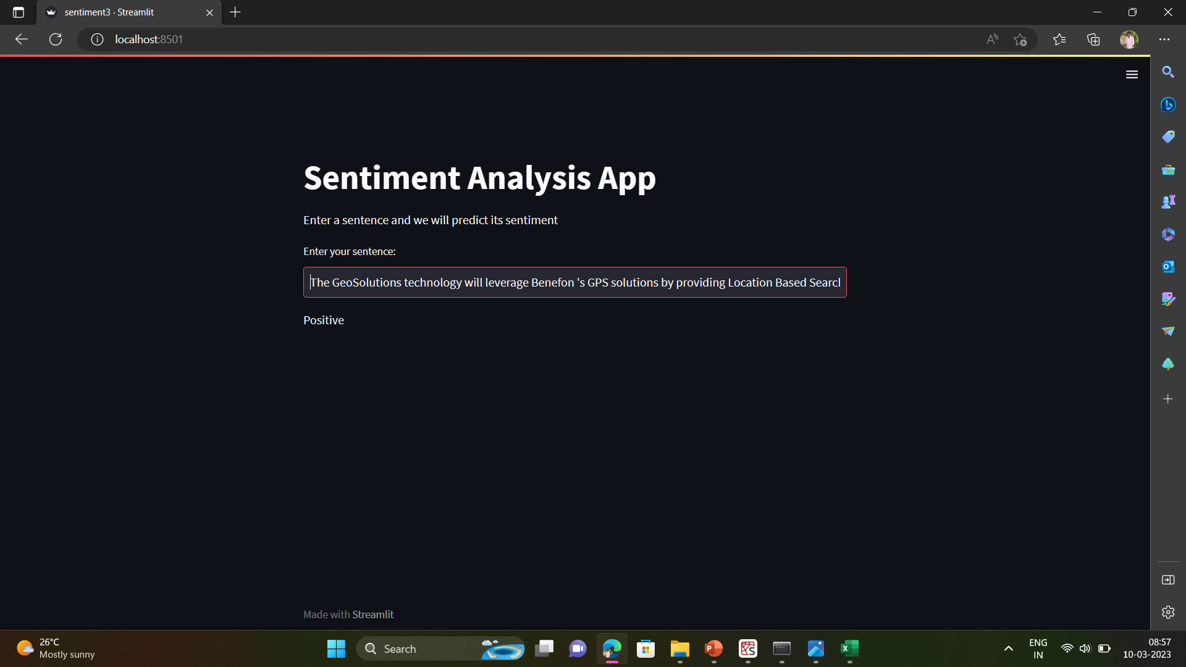
SENTIMENT ANALYSIS APP:
Checking for positive statement

Slide 25
Challenges Faced:
Data Availability: Finding enough relevant and accurate data to support the analysis and findings was challenging.
Data Quality: Ensuring the quality of data collected and making sure it is reliable and unbiased.
Data Analysis: Selecting the appropriate method for data analysis and making sure the results are statistically significant.
Visualization: Presenting the data and findings in an effective and easily understandable manner using visualizations.

Slide 26


